Slide 1

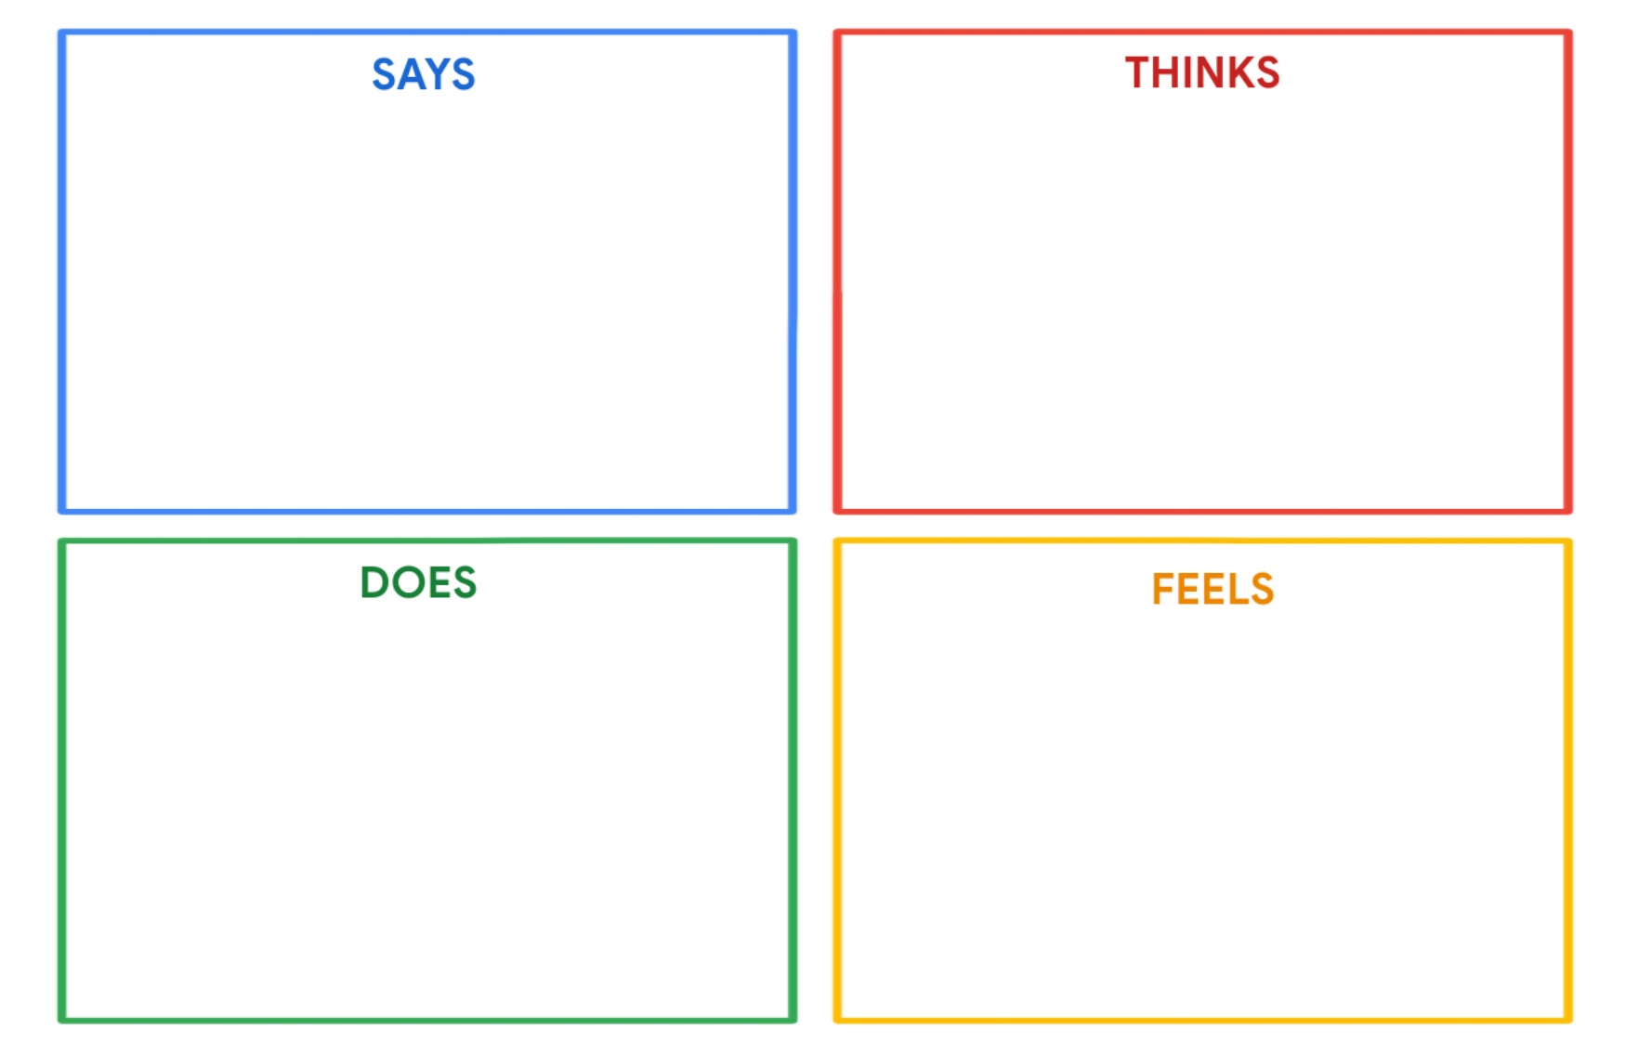
Kareem Hassan
"I want to become an engineer and make the world a better place."
"I love spending time outdoors, exploring nature."
"I enjoy tinkering with gadgets and figuring out how they work."
"I find complex learning a bit challenging and overwhelming."
"I wonder how I can use my engineering skills to have a positive impact on the environment."
"I'm curious about programming and how it can help me in my future career."
"I wish there were more exciting and fun ways to learn complex subjects."
"I dream of creating innovative solutions to real-world problems."
Kareem spends time exploring the outdoors, hiking, and enjoying nature.
He seeks out online resources and books to learn about engineering and programming.
Kareem may get frustrated when faced with boring or overly complex learning materials.
Kareem is enthusiastic and optimistic about his goal of becoming an engineer.
He feels a strong connection to the natural world and is inspired by it.
He is eager to learn programming, but complex topics may make him anxious.
Boring learning methods can make him feel disengaged and frustrated.

